Slide 1
Offerly - Online Auctioning
Group 6
Jacob Johnston, Tiffany Morrow, Nicholas Vioral, Wolfgang Zoppelt

Slide 2
Synopsis
The goal this semester was to modernize Offerly and shift gears towards a social marketplace application.
We added features to allow customers to interact and communicate with one another over buying and selling goods.
We improved the way listings are created, viewed, updated and sold.
The structure of the website has been expanded upon and revamped.

Slide 3
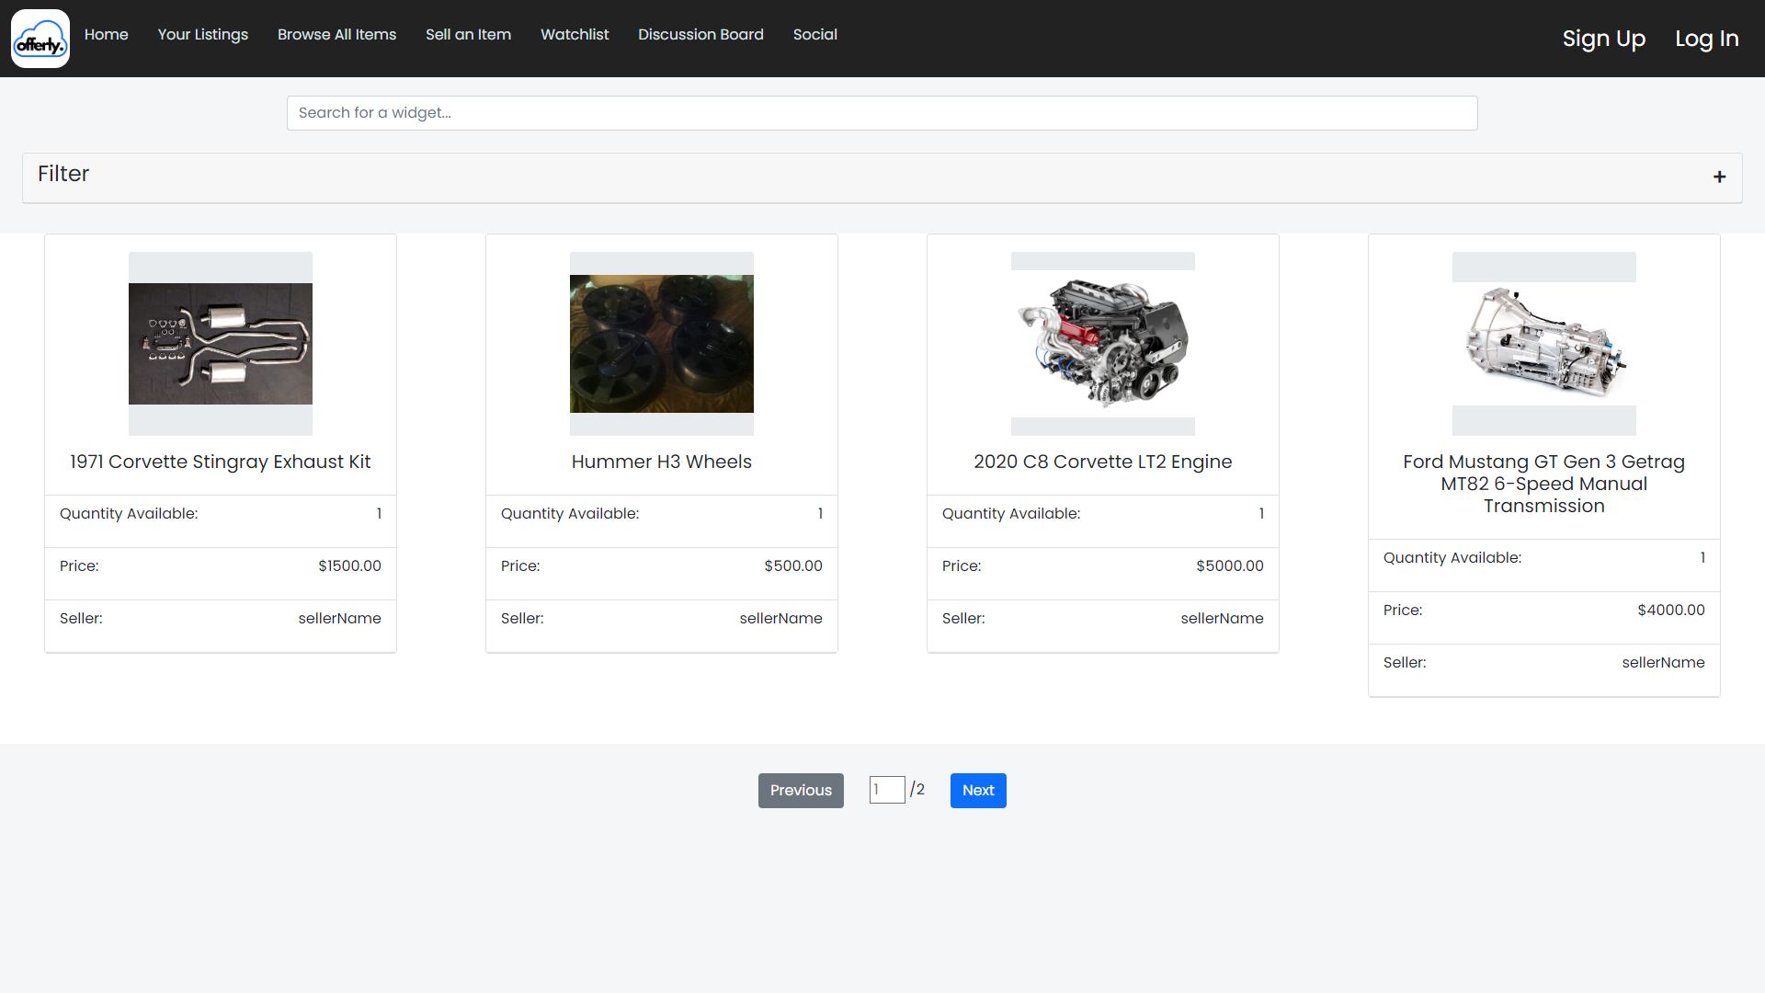
Improved Listing, Home and Browsing Pages
Changed the landing page to the Browse page
Added pagination to Browse page
Added Filter to Browse Page

Slide 4
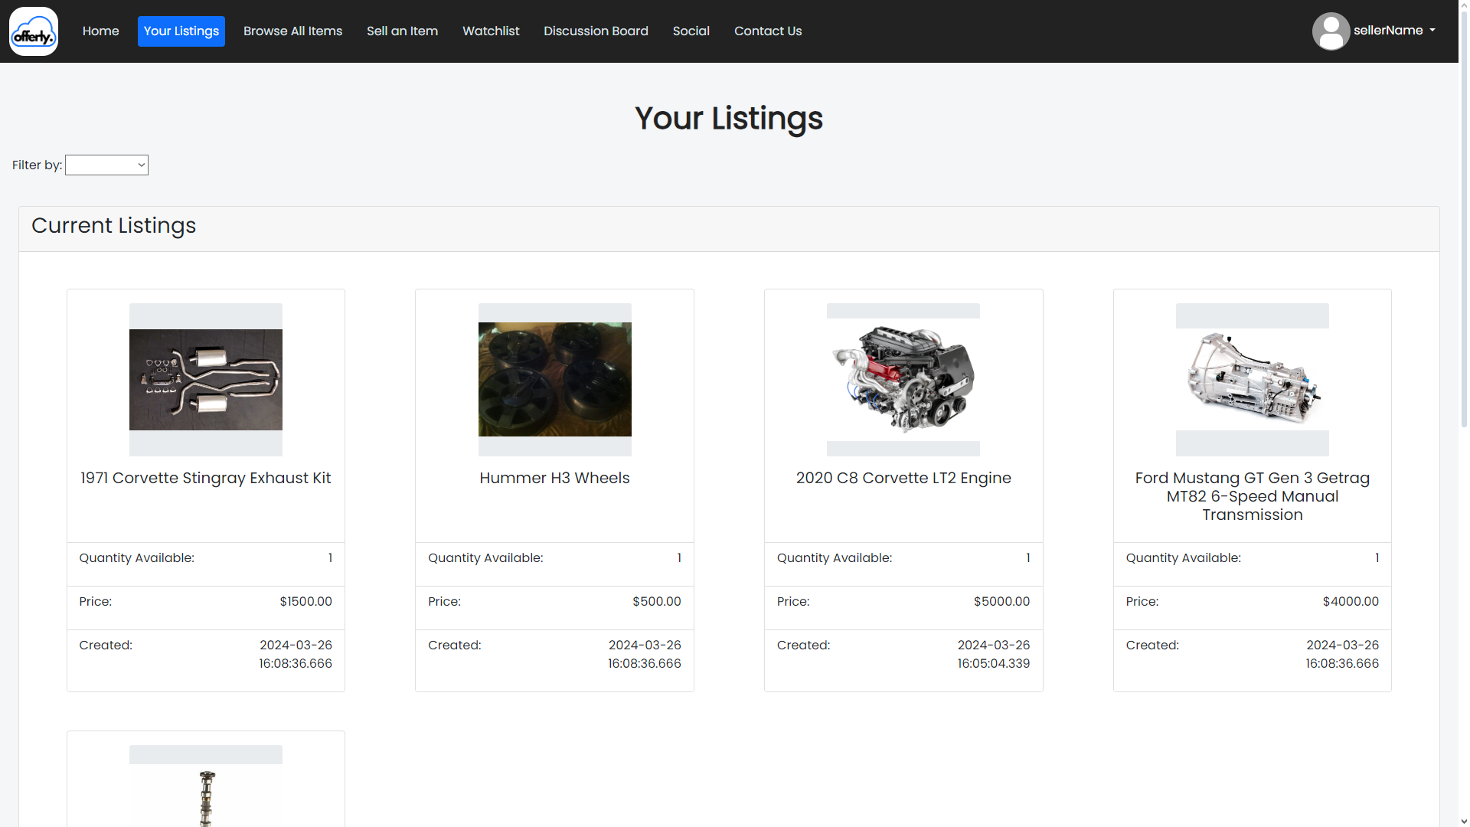
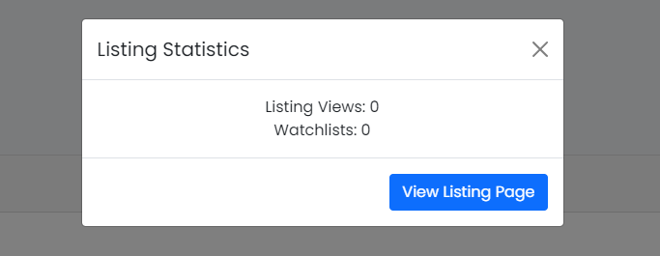
Improved Listing, Home and Browsing Pages
Created a “Your Listings” page
Can see when you created the listing
Filter by last week, month, or year
Quickly view listing statistics
Easy access to listing and transaction pages

Slide 5
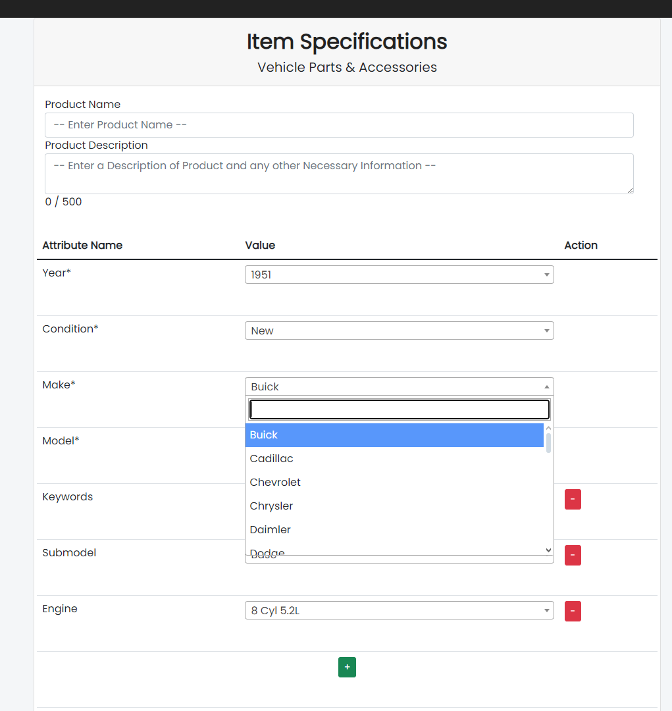
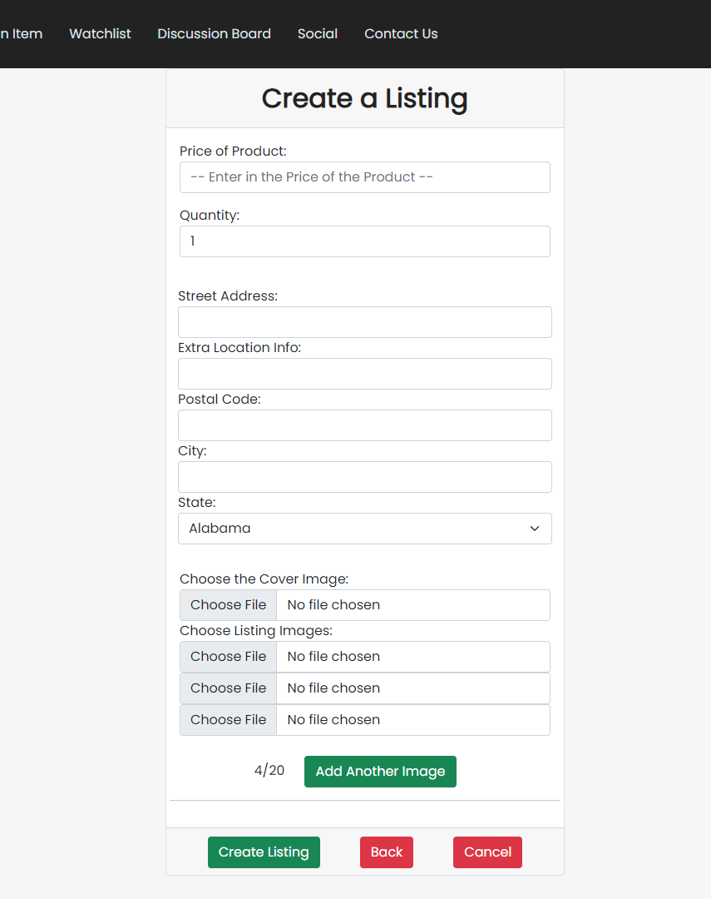
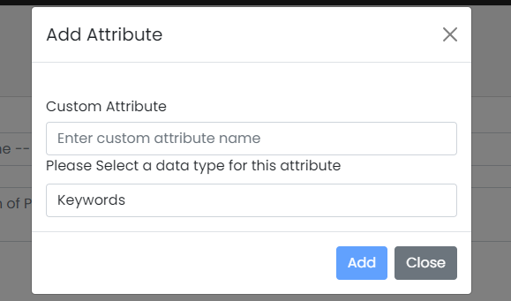
Improved Listing Creation
Listing attributes now come with suggestions
Alternatively, you can create your own
More intuitive to add listing images

Slide 6
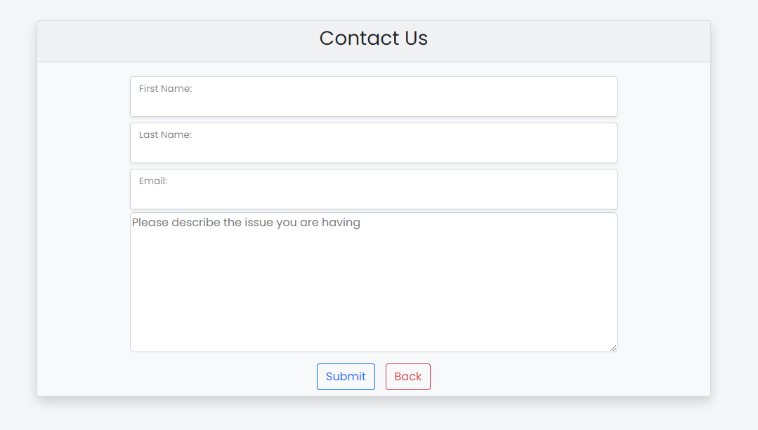
Contact Us Page
The interaction between customers and employees underwent enhancements, becoming more streamlined.
The Contact form functionality enables customers to freely provide their contact details and express any issues or concerns they may have.
Subsequently, these forms are converted into tickets routed to the Customer Service department for addressing customer inquiries.
Based on their content, these tickets may then be redirected to IT or other relevant employee departments for further handling.

Slide 7
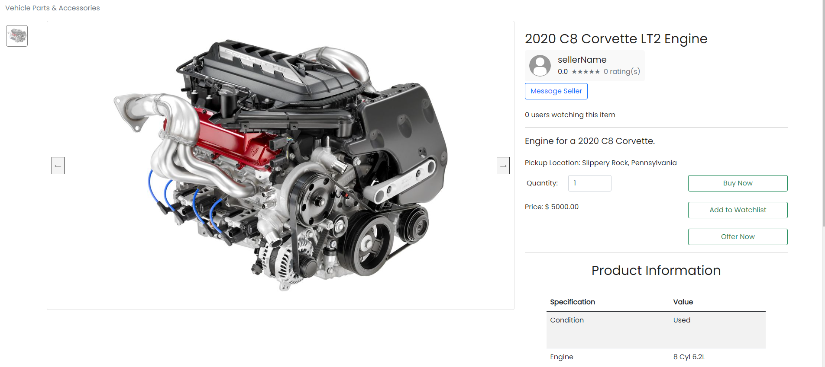
Offer System
We shifted focus from a bidding system to a new offer system
A customer can submit an offer to the merchant on a listing
The merchant may choose to accept/reject offers - an automatic response will update the user
Listings now have status attribute to show item availability
If an offer is accepted, the listing will go into a pending state to allow the user with the highest offer to buy at the new listing price

Slide 8
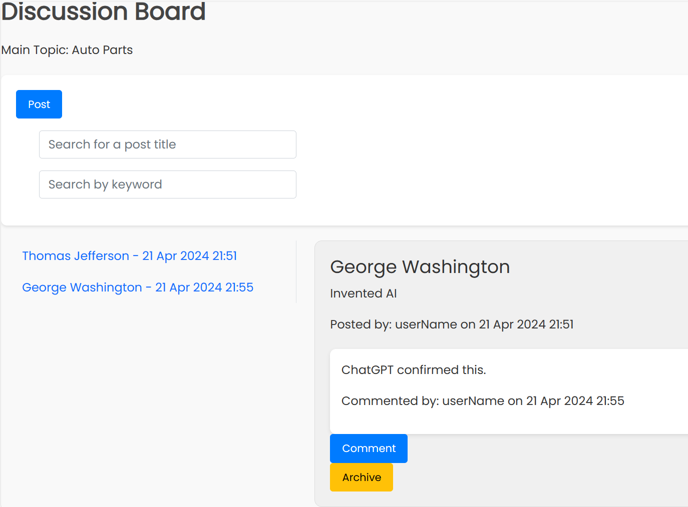
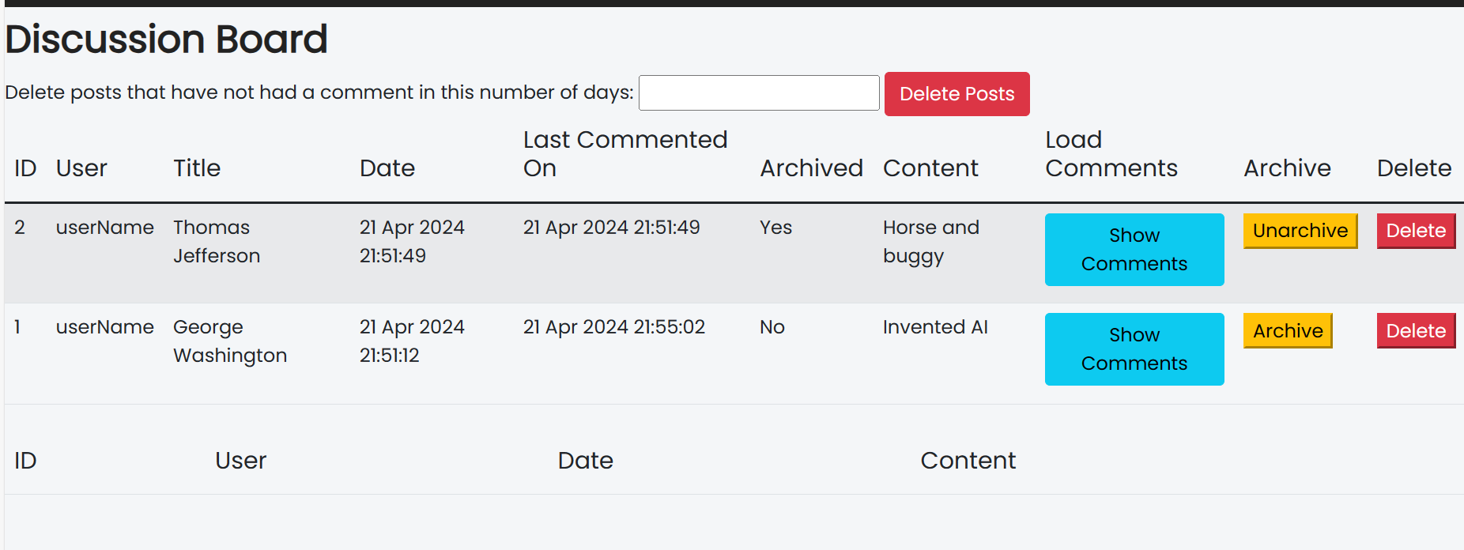
Discussion Board
Created Discussion board page so users can interact, share ideas, do research and communicate with each other.
Promotes a sense of community among the users.
Get answers to questions from like-minded users that may have had the same issue.
Admin's view allows them to have control over discussion board posts, Archiving and Deleting posts when appropriate

Slide 9

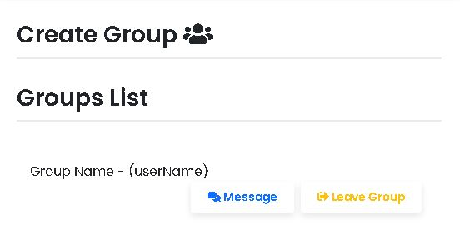
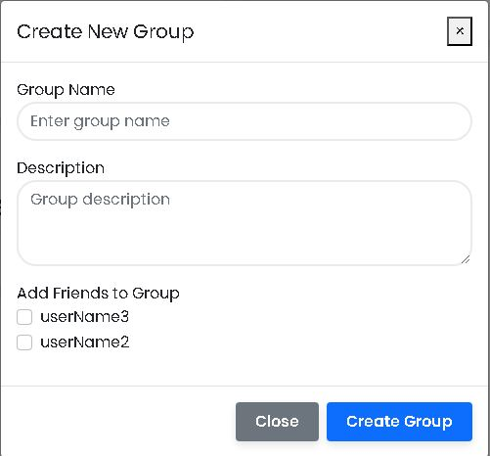
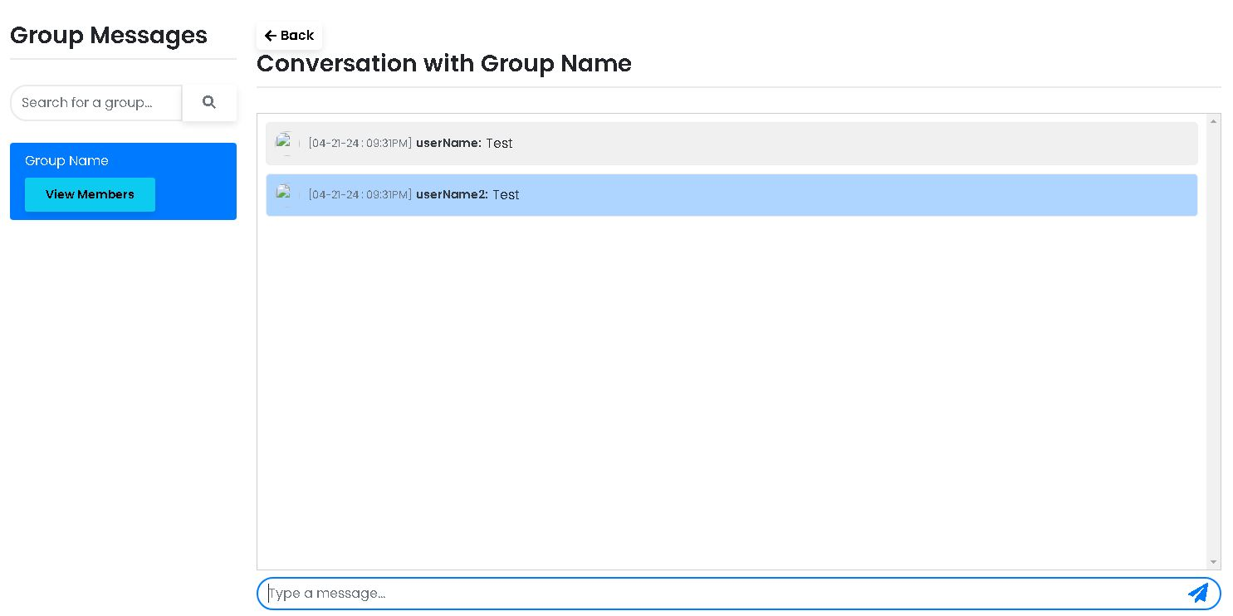
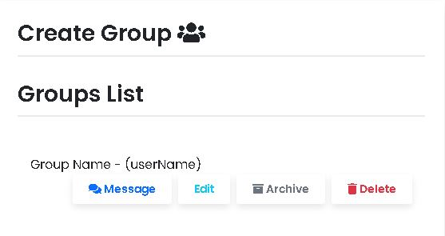
Group Messaging
Created a way for users to interact with 2 or more friends at once
A user creates a group by entering a name, providing a description of the group, and adding at least 1 friend
Owners can add or remove members, along with the ability to archive or delete the group
Regular members are allowed to leave the group at any time
Members receive notifications when messages are sent

Slide 10
Future Work
Improving Status settings for listings
Completing Admin view for Discussion board
Follow or Track Discussion Posts feature with notifications
Messaging UI improvement
Group Notifications for all users
Timers for Pending Status on Listings
Timers for Discussion Posts
Sort Listings by popularity

Slide 11
Conclusion
To summarize, Offerly has evolved into a comprehensive marketplace that caters to a wide array of consumer needs.
We have expanded and enhanced the platform given to us to give it an accessible, engaging, and personalized feel.
The experience of working on this program was rewarding and insightful.

Slide 12
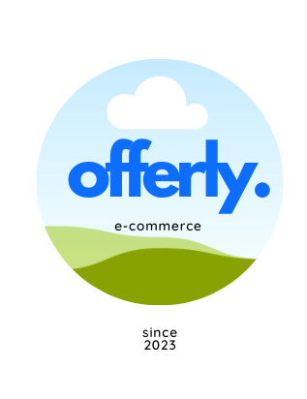
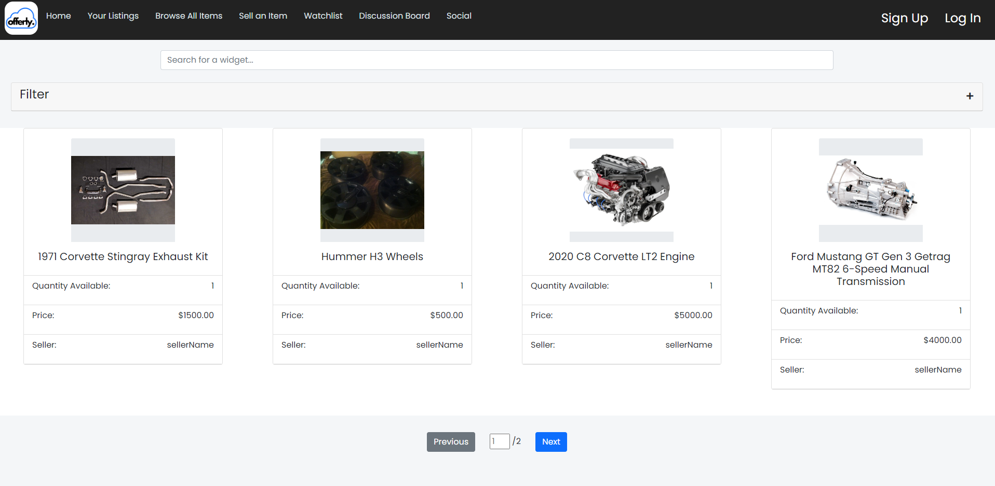
Demo
https://205.149.70.77:8443/OnlineAuction/

